Slide 1
World War Two
1939-1945

Slide 2
The Origins of WW II in Europe: Introduction
World War Two began in 1939, when Germany invaded Poland. This act led to a war that eventually pitted the Axis Powers (Germany, Italy and Japan) against the Allied Powers (Britain, France, the Soviet Union and the U.S.).
Although the invasion of Poland was the spark that began the war, there were many underlying causes. In particular, new political ideas promoted war.

Slide 3
The Rise of Dictators
In Europe, the Great Depression caused the rise of new political beliefs and systems. In Italy, Benito Mussolini established fascism – a totalitarian system in which the government controlled all aspects of life and used terror to enforce its policies.
In Germany, Adolf Hitler and the Nazis gained power. Nazism was a type of fascism that encouraged strong feelings of national pride, anti-Semitism (hatred of Jews) and the use of violence.
Under Nazism, human rights were crushed. Rival political parties and criticism of the government were banned.
Once in power, these dictators demanded more territory from neighboring countries.

Slide 4
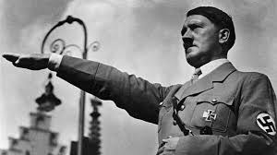
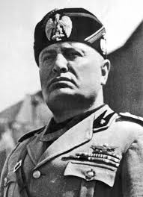
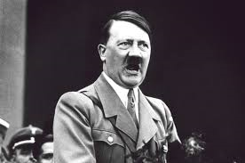
Rise of Fascist Dictators: Mussolini and Hitler

Slide 5
The United States Tries to Remain Neutral
With fascists in control of much of Europe in the late 1930s, war became increasingly likely. Congress passed a series of laws to keep America out of a new European war. In 1917, the United States had become involved in WW1 when Germany attacked American ships bringing supplies to Great Britain and France.
To avoid a similar situation, Congress passed the Neutrality Acts (1935-1937).
These prohibited Americans from traveling on the ships of nations at war or from selling arms to countries at war.

Slide 6
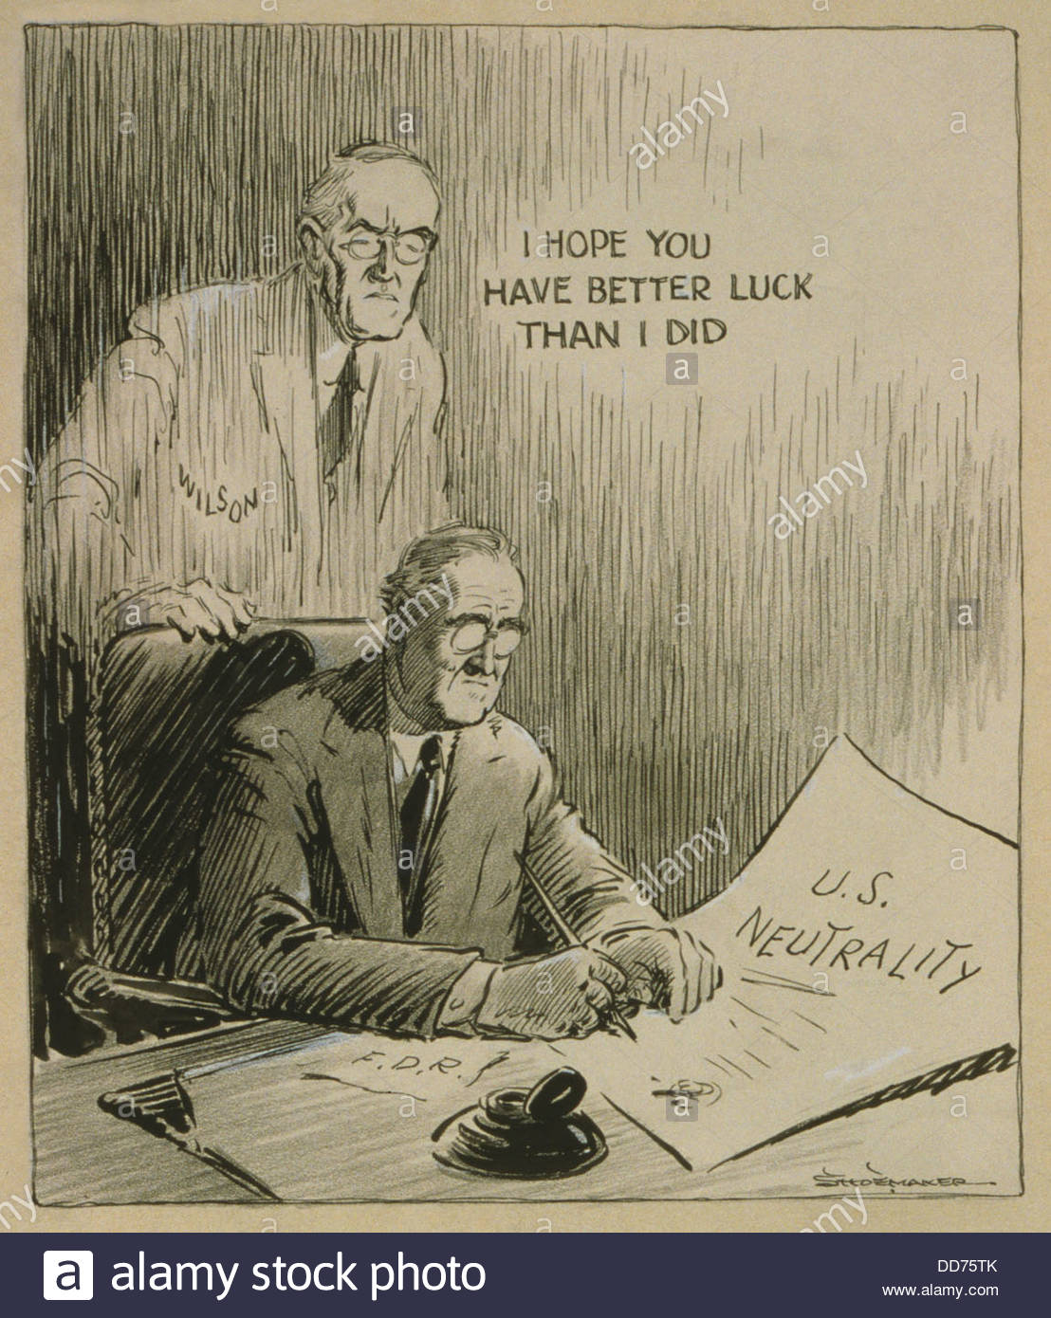
Roosevelt Struggles With Neutrality

Slide 7
The U.S. Tries to Remain Neutral
Despite public opposition to war, President Roosevelt began making preparations in case the U.S. was dragged into the conflict.
Congress increased spending on the army and navy. In 1940, it set up the first peacetime draft for men between the ages of 21 and 35. In 1941, Congress passed a law that allowed the U.S. government to send or lend war materials to countries fighting against Germany, Italy and Japan.
Soon U.S. battleships began protecting British ships carrying supplies. It seemed that American involvement in the war was just a matter of time.

Slide 8
America Enters World War Two, 1941
Surprisingly, events in Asia, not Europe, finally brought the U.S. into the war. In 1937, Japan had invaded China. Later, Japan took over parts of Southeast Asia. President Roosevelt felt that American interests in Asia and the Pacific were threatened by Japan’s expansion. He cut off all US trade with Japan, agreeing to resume trade only if Japan withdrew its forces.
Late in 1941, Japanese military leaders decided to launch a surprise attack against the U.S., believing that they would catch Americans unprepared and eliminate U.S naval power in the Pacific.

Slide 9
American Expansion Across the Pacific

Slide 10
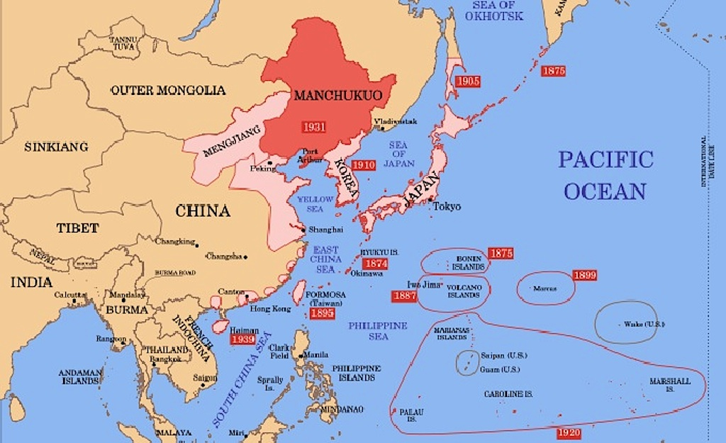
Japanese Expansion Across Pacific

Slide 11
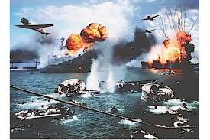
Japan Attacks US
On December 7, 1941, Japanese planes attacked the U.S. Pacific Fleet stationed at Pearl Harbor, Hawaii.
They destroyed 200 planes, sank 19 ships, and killed over 2,400 Americans. The following day, President Roosevelt asked Congress to declare war on Japan. Soon after, Japan’s allies, Germany and Italy declared war on the United States.

Slide 12
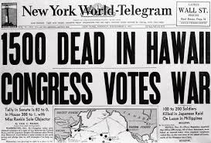
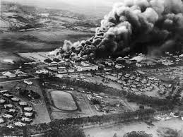
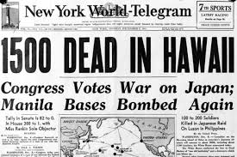
Pearl Harbor

